Slide 1

Antique Forum & Classifieds
Angela Holbrook
Austin Langston
Luke Monk
Jordan stong

Slide 2
Overview
Architecture Design & Business requirements
Weekly Meeting Minutes
Documentation
Working Solution

Slide 3

Architecture Design & Business requirements
State, Activity, Overall Architecture Diagram, ERD
Business Requirements & User stories
Sitemap layout

Slide 4
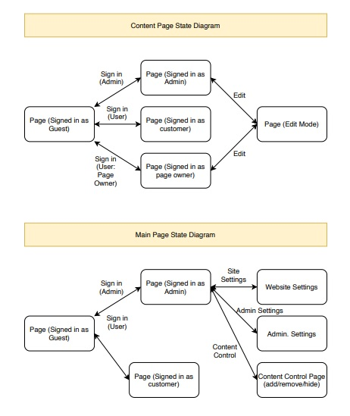
State Diagram

Slide 5

Activity Diagrams
Main, content, classifieds

Slide 6
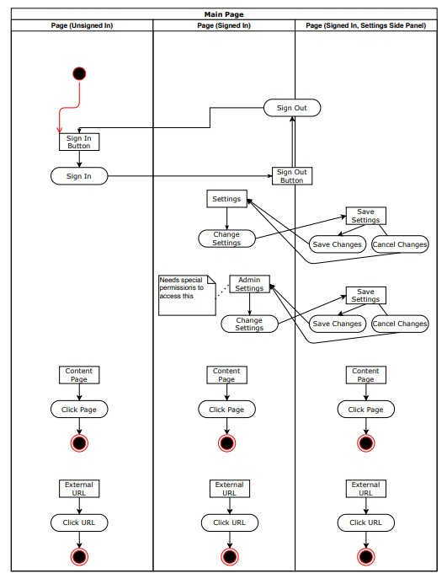
Activity Diagrams - Main

Slide 7
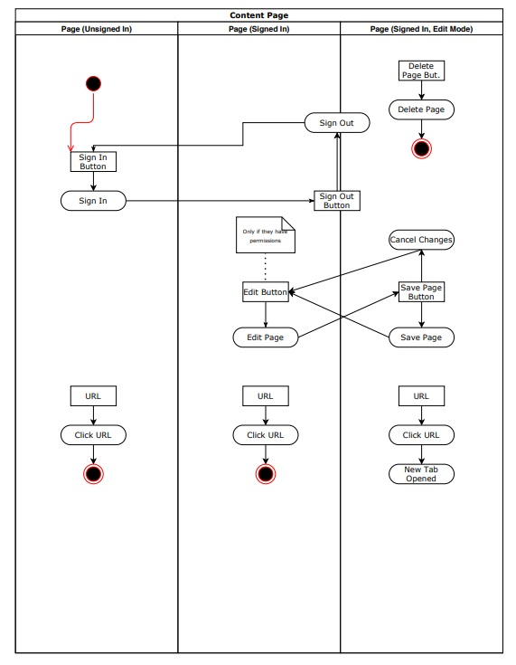
Activity Diagrams - Content

Slide 8
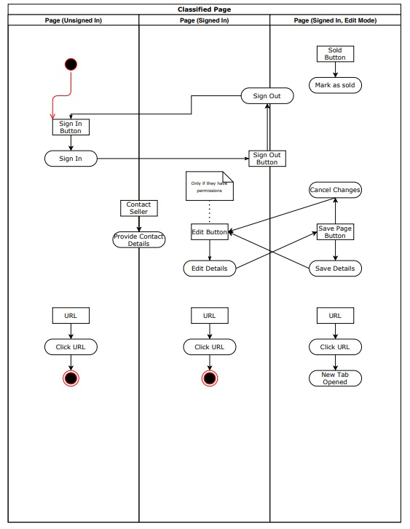
Activity Diagrams – Classifieds

Slide 9
Sequence Diagrams
Auth User
create post
Display more articles
search for article

Slide 10
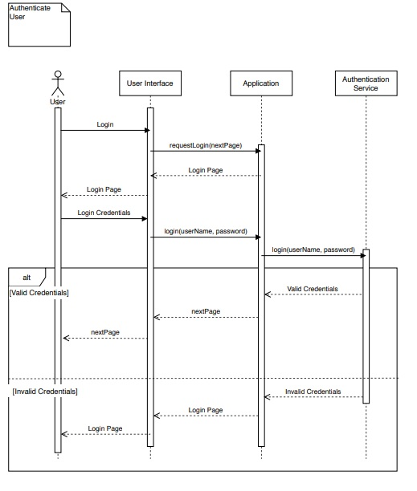
S.D.-Authenticate user

Slide 11
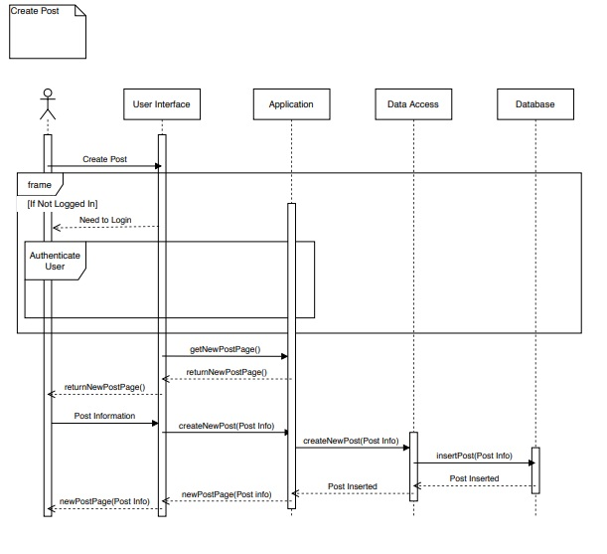
S.D. –Create post

Slide 12
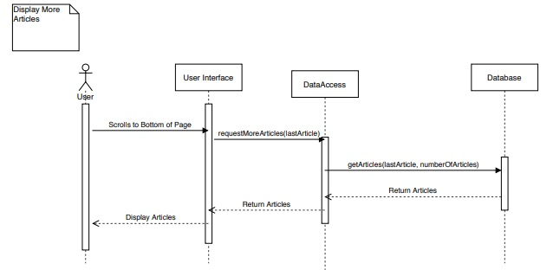
S.D.–display more articles

Slide 13
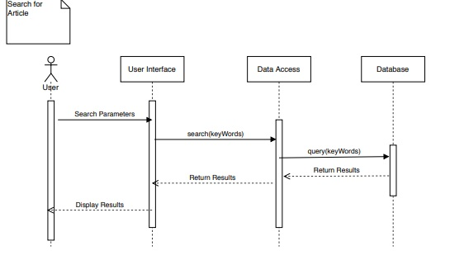
S.D. –search for article

Slide 14
Overall Architecture Diagram

Slide 15
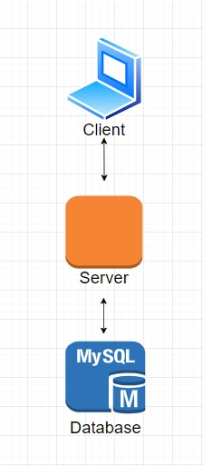
Overall architecture diagram

Slide 16
erd
Database

Slide 17
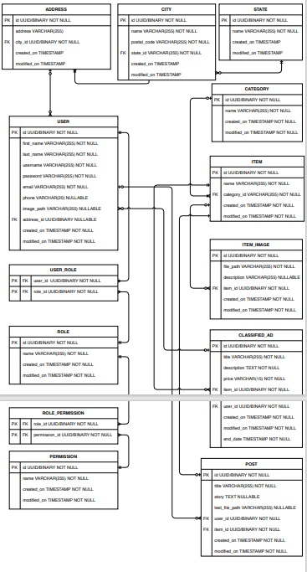
database

Slide 18
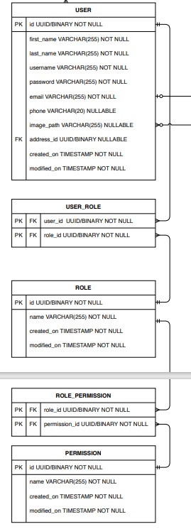
Database – a better view

Slide 19
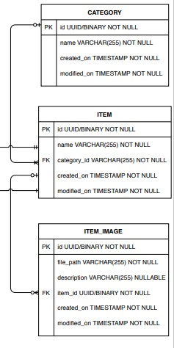
Database – a better view cont.

Slide 20
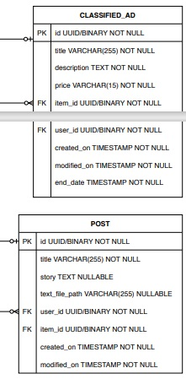
Database – a better view cont.

Slide 21
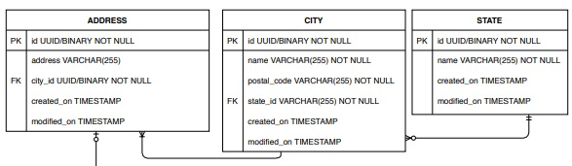
Database – a better view cont.

Slide 22

Business requirements
We want a forum-based website that people can post about antiques. We want to be able to have a hidden classifieds section available only to registered users. We would like to have the forum load up only a few of the most recent posts unless the user browses to load older posts. Additionally, we want an Administration based role to enable complete control over users and content.

Slide 23
User stories
Roles

Slide 24
User Stories
Unsigned in User
Signed in User
I am an unsigned in user and I want to be able to browse the forum so that I can see what this site as to offer before I decide if I want to sign up.
I am a signed-in user (non moderator and non administrator) and I want to be able to do what the unsigned user wants to do and be able to post to the forum and be able to view and list in the classifieds. Additionally, I want to be able to edit/ delete my content. So that I can participate in topics and sell items that I have.

Slide 25
User Stories cont.
Moderator
Administrator
I am a moderator and I want to be able to have all the permissions of signed in user as well as be able to modify/ delete the content of signed-in users so that I can help make sure that the site runs as expected.
I am an administrator and I want to be able be able to have complete abilities to modify all content so that I can make the site what I want it to be.

Slide 26
Sitemap

Slide 27
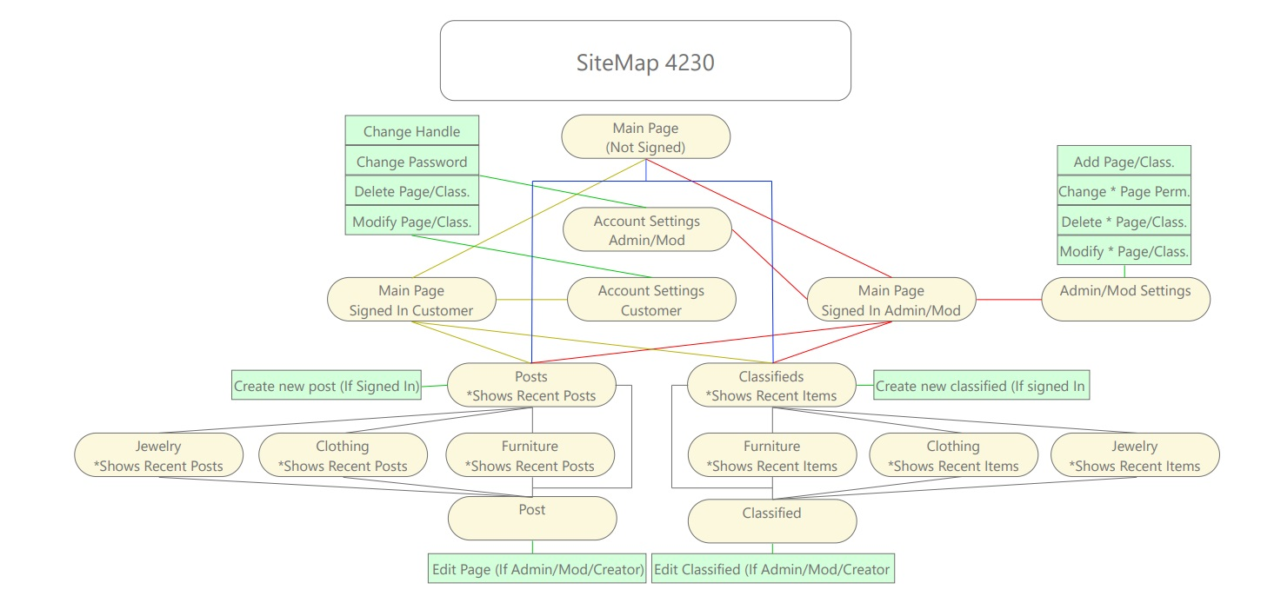
Sitemap

Slide 28
Meetings
Technologies chosen
Slack
Trello
Problems & Solutions

Slide 29
Technologies chosen
ThymeLeaf
MySQL
Swagger
Docker
SpringBoot

Slide 30
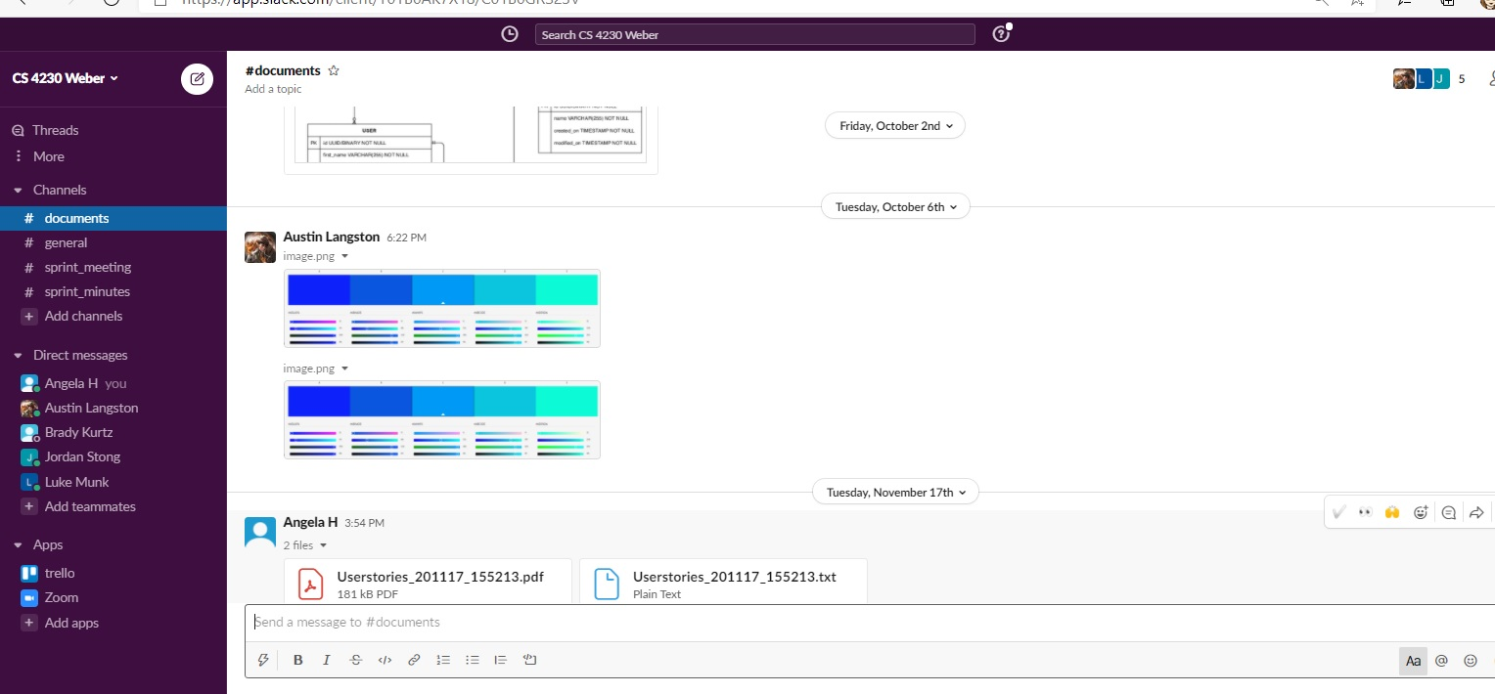
Team communications

Slide 31
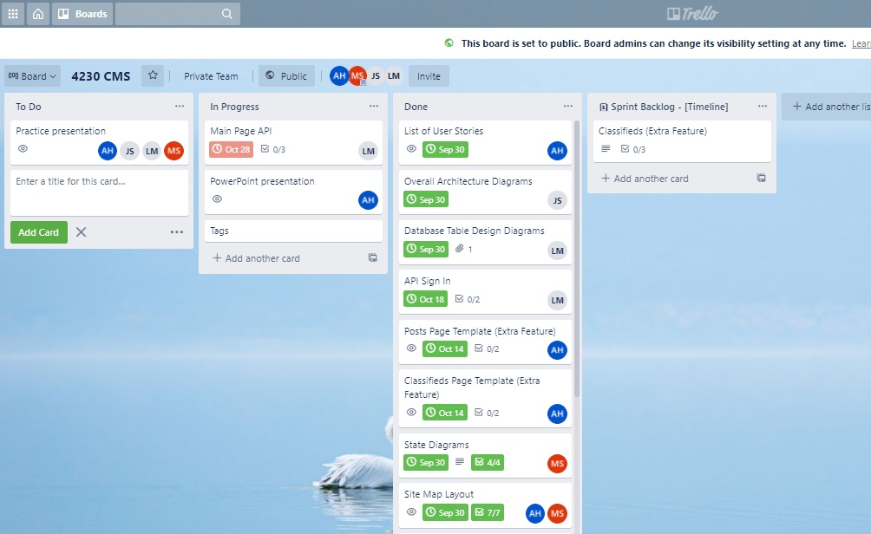
Sprints - Trello

Slide 32
Problems & solutions
Security for SpringBoot Authentication wasn’t authorizing – Cast user instance to SpringBoot user details
API Security – Needed to ask for the jwt token in call.
Tags – Missed requirement initially so updated DB, ERD, UI and code. Then adding the tag wouldn’t show up until Ajax calls were done. Additionally, it conflicted with the search capability, so the search was changed

Slide 33

Documentation
Technical & User Documentation
User Views
Build & Run
How to deploy

Slide 34
Technical & user Documentation

Slide 35
Extra feature
Classified Ads
Signed in feature
Pictures
Prices

Slide 36
User views
Unsigned in
standard
Moderator
admin

Slide 37
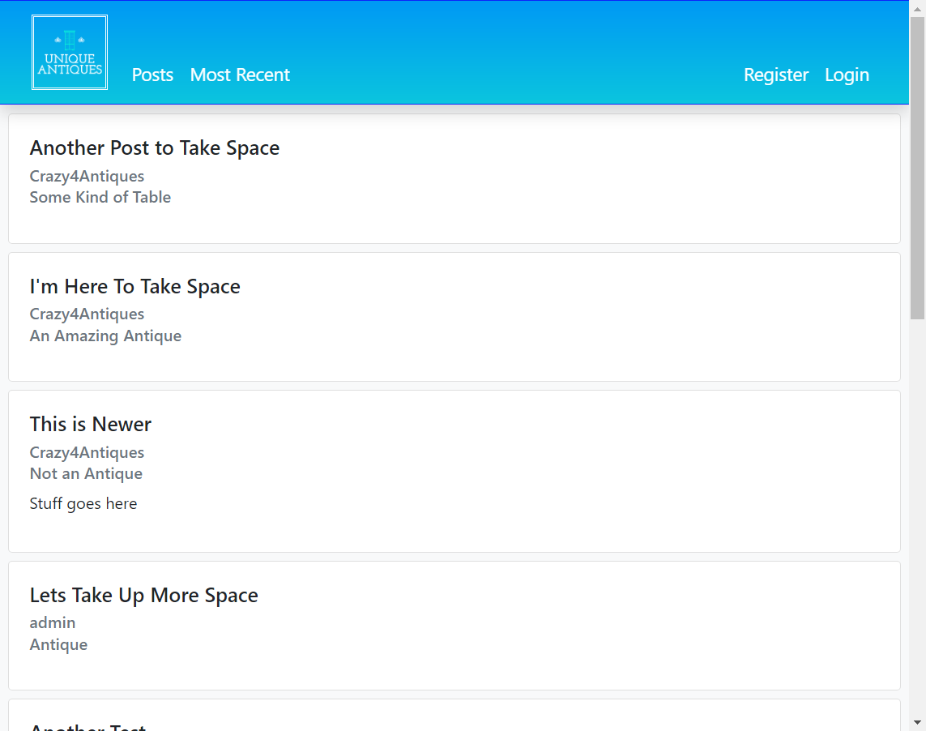
Unsigned in

Slide 38
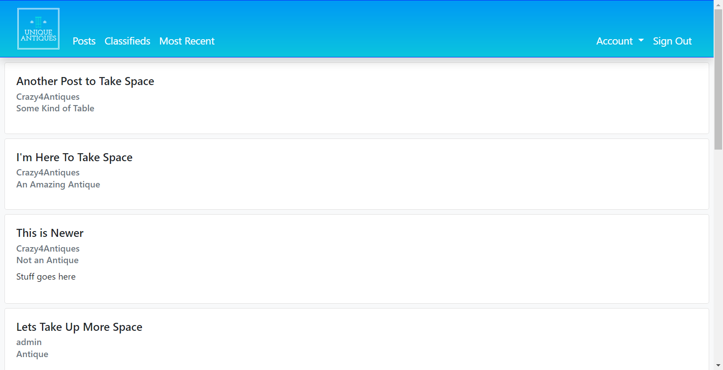
signed in

Slide 39
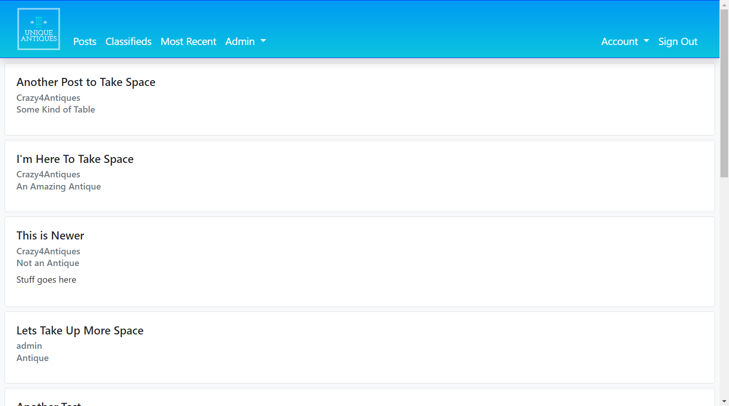
admin

Slide 40
General features
Logging in
Register account
Password reset

Slide 41
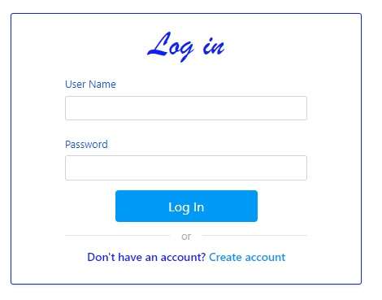
account log in

Slide 42
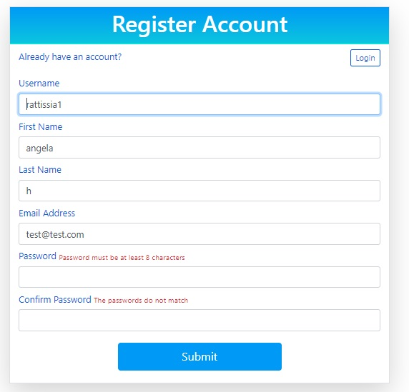
Register account-info checked

Slide 43
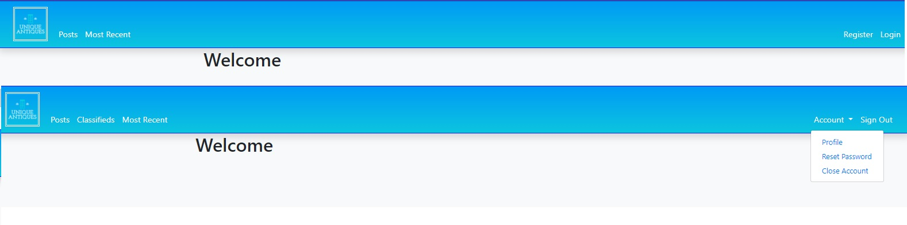
account logged in

Slide 44
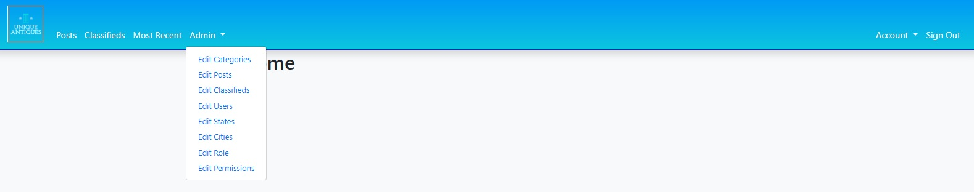
Admin account logged in

Slide 45

Reset password

Slide 46
Admin features
Edit
Categories
Posts
Classifieds
Users
States & cities
Roles
Permissions

Slide 47
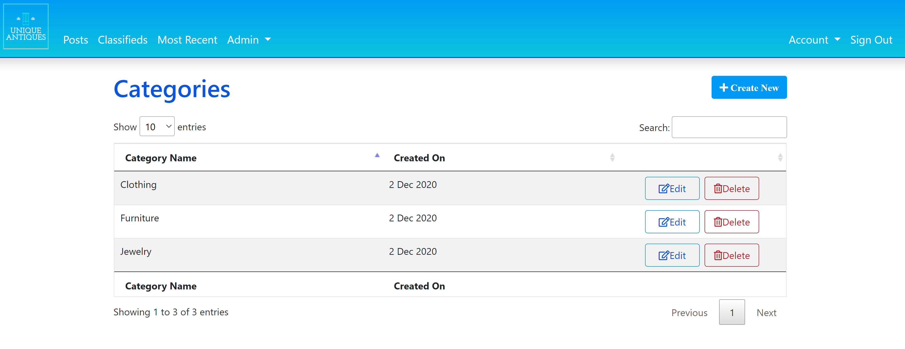
Edit categories

Slide 48
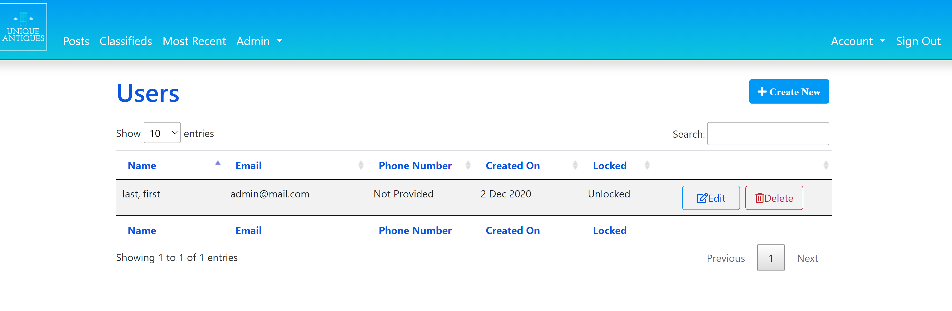
Edit users

Slide 49
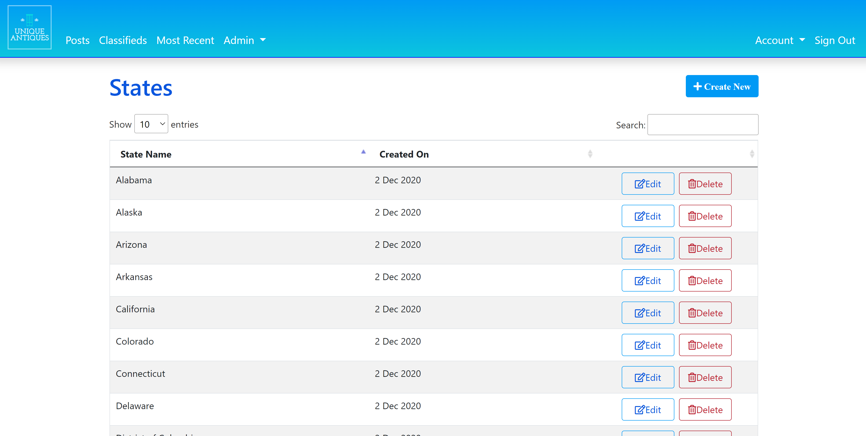
Edit states

Slide 50
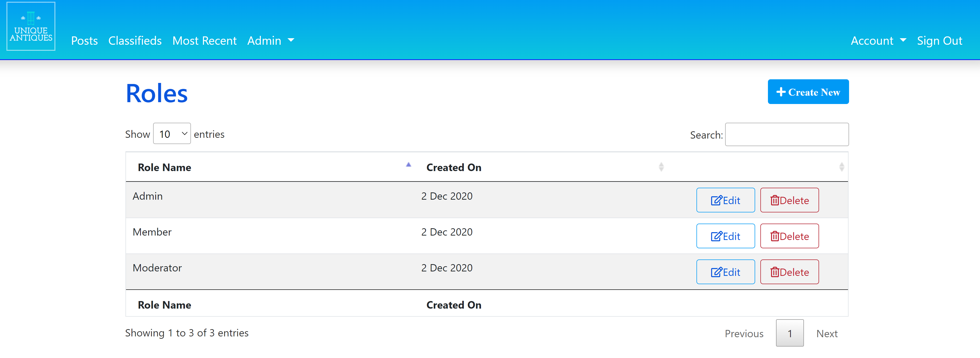
Edit roles

Slide 51
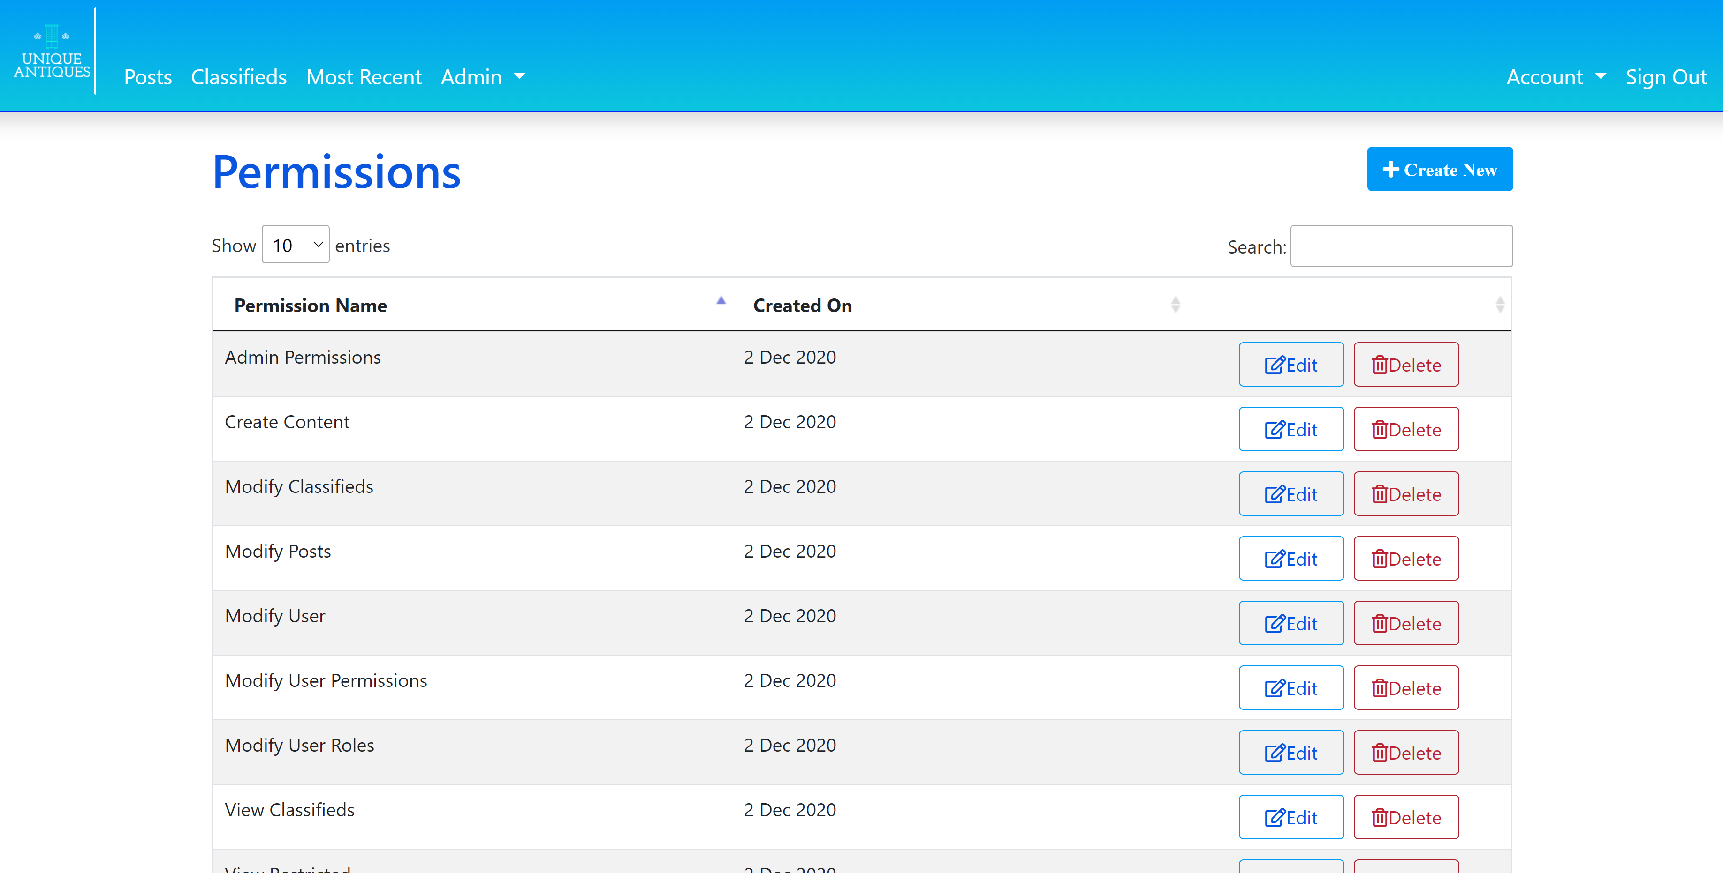
Edit permission

Slide 52

Slide title 29
DEMO

